Slide 1
Aggregate Intellect Detecting citations context in scientiﬁc papers
Viraja Ketkar & Sumaira Afzal

Slide 2
Why it is useful?
Automatic detection of citation context can be used for sentiment analysis of citation which can also be used as a ﬁrst step to scientiﬁc summarisation.
It can help researchers during search,
by identifying problems with a particular approach
by recognising unaddressed issues and possible gaps in the current research

Slide 3
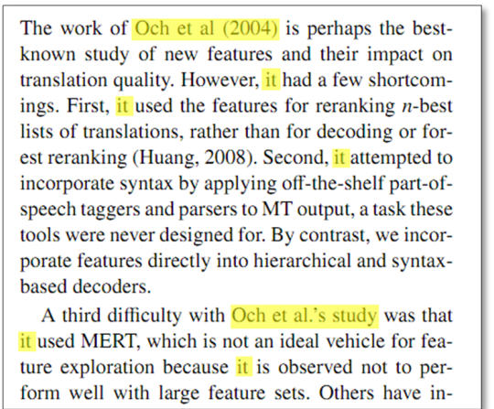
Challenge
Looking at the first citation sentence, we lose the hidden context in the text

Slide 4
Proposed Solution
Topic modelling with Latent Dirichlet Allocation(LDA)

Slide 5
Project Pipeline
List of citing papers
Clean data
Input(Dictionary and corpus)
PDF contents of citing papers
Tokenize data
LDA Model
sentences that refer paper A
Normalize data
Model evaluation
Collect and save all sentences
Bi-gram and Tri-gram
Hyperparameter tuning

Slide 6
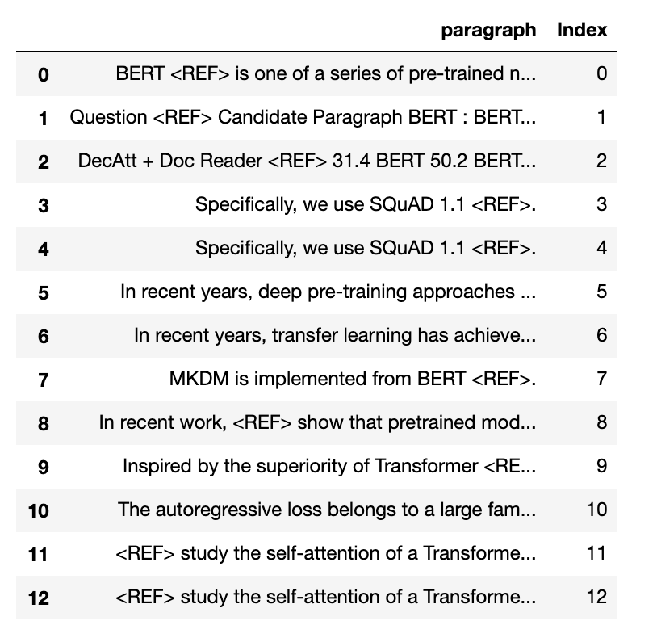
Data Gathering
Download the pdf
Get xml file ( GROBID tool)
!cd grobid-client-python && python grobid-client.py --input ../input --output ../output processFulltextDocument --force
Get the reference nodes
Match the ref node with the target ref node xml file
Get the paragraph
Extract the reference sentences from paragraph
Save to csv using Pandas Dataframe

Slide 7
Data Preprocessing
Clean text (punctuation removal, stopwords removal)
Tokenize and Vectorize the text (BOW, CountVectorizer)
Stemming (Snowball Stemmer)(Doubtedly=Doubt)
Lemmatization (Ate=eat)
Bi-grams, Tri-grams
Create Dictionary (corpus)
token= word, document= sentence or paragraph, corpus = collection of documents
For each document, a corpus contains each word’s id and its frequency count in that document

Slide 8
What is Topic Modelling
Suppose that you want to study a large text corpus.
You want to identify specific topics that are discussed in this dataset and then either study the topics that are interesting for you or just look at their general distribution, do topical information retrieval etc.
However, you do not know the topics in advance.
Thus, you need to somehow extract what topics are discussed and find which topics are relevant for a specific document, in a completely unsupervised way because you do not know anything except the text corpus itself.
This is precisely the problem that topic modeling solves

Slide 9
Latent Dirichlet allocation
LDA is a probabilistic model that extracts topics from a corpus of documents.
By training the model, we decompose the word-document matrix into word-topic and topic-document matrices.
There are many topics, and it is desirable to distinguish interesting ones.

Slide 10
LDA Topic Distribution Example
Documents
Doc1-apple banana
Doc2-apple orange
Doc3-banana orange
Doc4-tiger cat
Doc5-tiger dog
Doc6-cat dog
 | Topic1(Fruit) | Topic2(Animal)
apple | 33% | 0%
banana | 33% | 0%
orange | 33% | 0%
tiger | 0% | 33%
cat | 0% | 33%
dog | 0% | 33%
 | Topic1(Fruit) | Topic2(Animal)
Doc1 | 100% | 0%
Doc2 | 100% | 0%
Doc3 | 100% | 0%
Doc4 | 0% | 100%
Doc5 | 0% | 100%
Doc6 | 0% | 100%

Slide 11
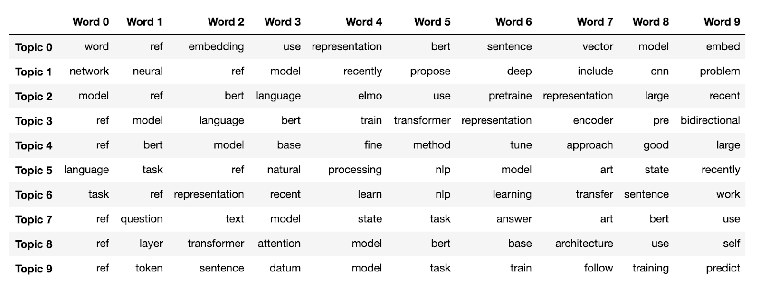
Topic-Word Representation
Product B
Product A
Feature 1
Feature 2
Feature 3
Feature 1
Feature 2
Feature 3

Slide 12
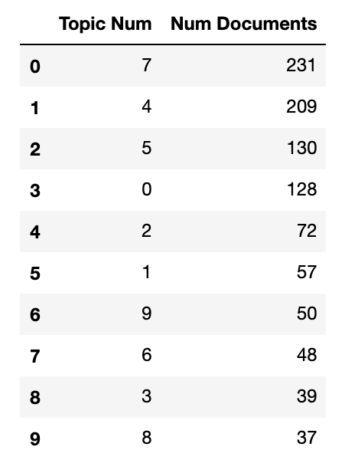
Topic Distribution Across Documents

Slide 13
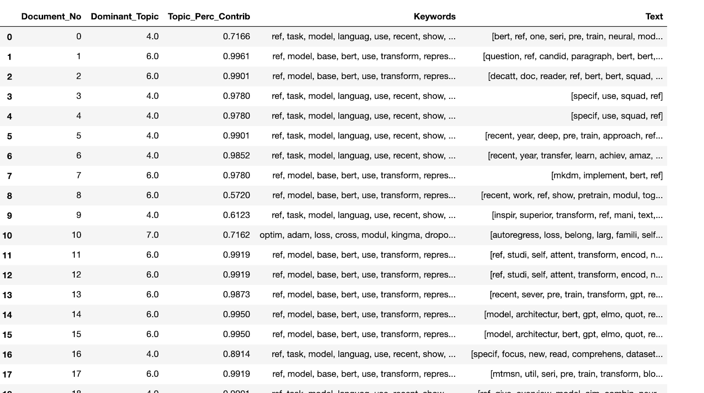
Dominant Topic Representation
Product B
Product A
Feature 1
Feature 2
Feature 3
Feature 1
Feature 2
Feature 3

Slide 14
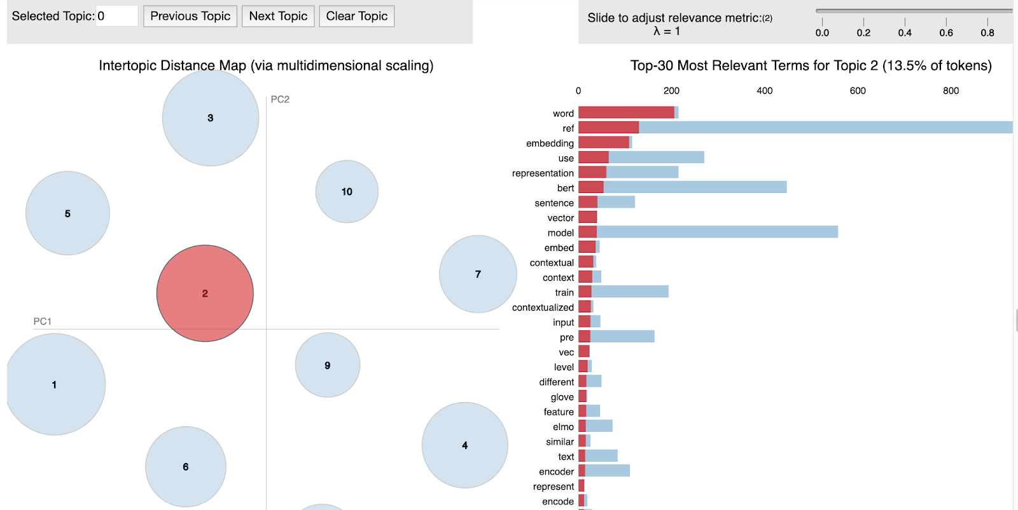
TOPIC-TERM Visualization

Slide 15
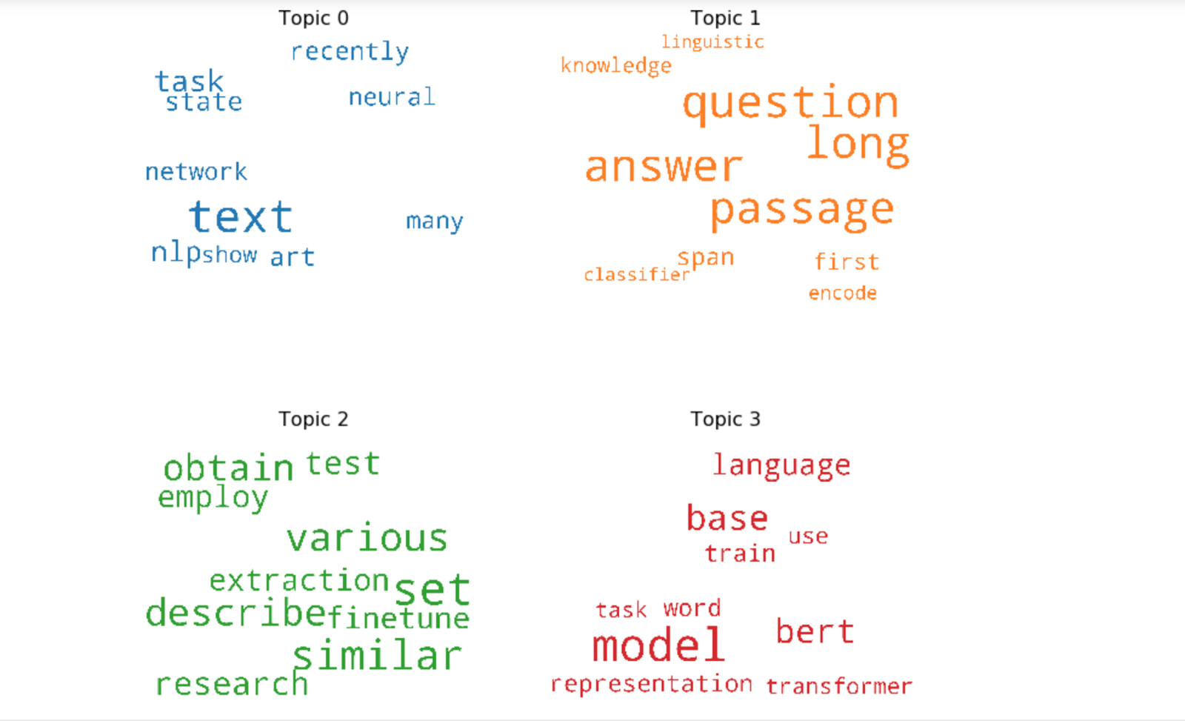
TOPIC-TERM WORD CLOUD Representation

Slide 16
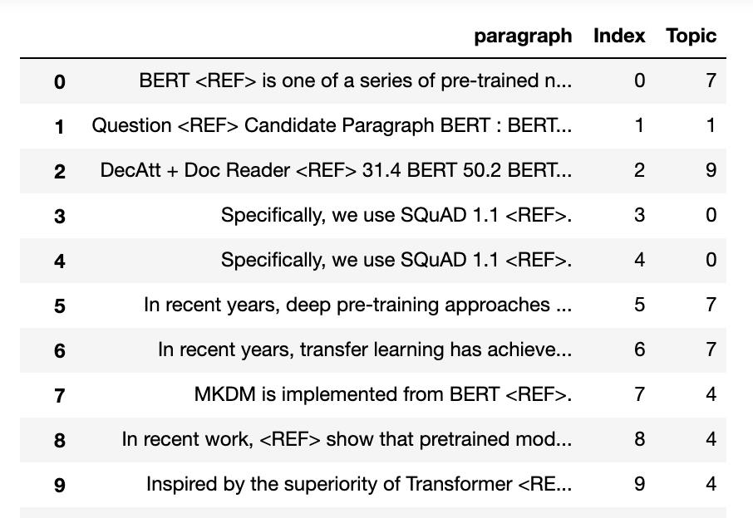
Topic With Original Sentences

Slide 17
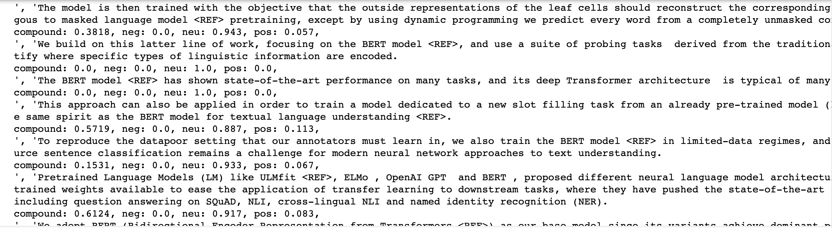
Experiment
Sentiment Analysis

Slide 18
Conclusion
With implementation LDA Model we were able to get :
Dominant Topics
Dominant-Topic with Words
Dominant Topic with Original sentences
From the above information we can easily make inference and detect citations context in scientific papers.

Slide 19
Future Work
Build topic model on a large collection of scientific documents.
Glove embedding with tfidf matrix

Slide 20
Thank You Xiang, Amir and Harish

